Slide 1

Control Flow Tools (if statement)
Dr/ Hanan Hamed Amin

Slide 2
Outline
Selection Structure
Conditional operators
Simple if statement
If … else statement
Elif statement
Common Mistakes
Exercises

Slide 3
Selection Structure
Statement | Description
if statement | if statement consists of a Boolean expression followed by one or more statements.
if...else statement | if statement can be followed by an optional else statement, which is executed when the Boolean expression is false.
nested if...else statements (elif) | You can use one if or else if statement inside another if or else if (elif) statement(s).

Slide 4
Conditional operators
The comparison operators are ==, >, <, >=, <=, and !=. The last one is for not equals.
There are three additional operators used to construct more complicated conditions: and, or, and not. Here are some examples:
grade>=80 and grade<90
score>1000 or time>=20
not (score >=80)

Slide 5
Conditional operators
Order of operations In terms of order of operations, and is done before or, so if you have a complicated condition that contains both, you may need parentheses around the or condition. Think of and as being like multiplication and or as being like addition.
Examples:
Suppose that: Grade=97 , x=8 , y=15
Grade >=90 and Grade<100 (is true)
x>5 and y<11 (is false)
x>5 or y <11 (is true)
x>5 and (y!=10 or x>7) (is true)
not(x>20) (is true)

Slide 6
Simple If statement - Overview
We will start with the simple if statement, which will evaluate whether a statement is true or false, and run code only in the case that the statement is true.

Slide 7
Simple If statement – Syntax
The syntax of a simple if statement in python is:

Slide 8
Simple If statement – Example
Let’s look at this example where we would use conditional statements:
X=5
if X == 5 :
print ('is 5')
print ('Still 5')
print ('Still 5')
X == 5 ?
Yes
print 'is 5'
No
print 'Still 5'
is 5
Still 5
Still 5
print 'Still 5'

Slide 9
Simple If statement – Example
Let’s look at this example where we would use conditional statements:
Suppose the passing grade on an exam is 60. The following code determines whether the condition “student’s grade is greater than or equal to 60” is true or false.
If the condition is true, then “Passed” is printed, and the next statement in order is performed.
If the condition is false, the printing is ignored, and the next statement in order is performed.
grade =97
if grade >= 60:
print('Passed')
print ('End')
grade =45
if grade >= 60:
print('Passed')
print ('End')
Passed
End
End

Slide 10
if ... else statement - Overview
if selection statement performs an indicated action only when the condition is true; otherwise the action is skipped.
if...else selection statement allows you to specify that different actions are to be performed when the condition is true and when it is false.

Slide 11
if ... else statement - Syntax
The syntax of an if … else statement in python is:

Slide 12
if ... else statement - Example
Let’s look at this example where we would use if … else statements:
The following code prints “Passed” or “failed” depends on the grade:
If the condition is true (grade>=60), then “Passed” is printed, and the next statement (after else) in order is performed.
If the condition is false (grade<60), then “Failed” is printed, and the next statement in order is performed.
grade =97
if grade >= 60:
print('Passed')
else:
print ('Failed')
print ('End')
grade =48
if grade >= 60:
print('Passed')
else:
print ('Failed')
print ('End')
Passed
End
Failed
End

Slide 13
if ... else statement - Example
An other example where we would use if … else statements:
x = 4
if x > 2 :
print ('Bigger')
else:
print ('Smaller')
print ('All done')
x = 4
no
x > 2
yes
print 'Smaller'
print 'Bigger'
Bigger
All Done
print 'All Done'

Slide 14
Elif statement
The nested if...else (elif) statement is used when the program requires more than one test expression.

Slide 15
Elif statement - Example
Let’s look at this example where we would use if … else statements:
grade =84
if grade >= 90:
print('A')
if grade >= 80 and grade <90:
print('B')
if grade >= 70 and grade <80:
print('C')
if grade >= 60 and grade <70:
print('D')
if grade < 60:
print('Failed')
grade =84
if grade >= 90:
print('A')
elif grade >= 80:
print('B')
elif grade >= 70:
print('C')
elif grade >= 60:
print('D')
else:
print('Failed')
B
B

Slide 16
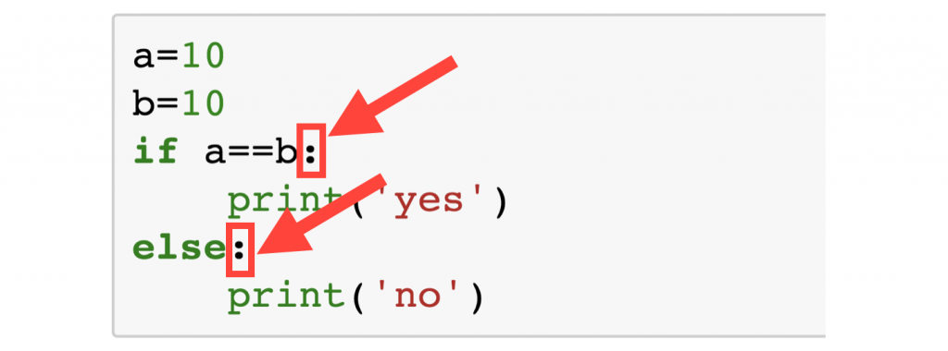
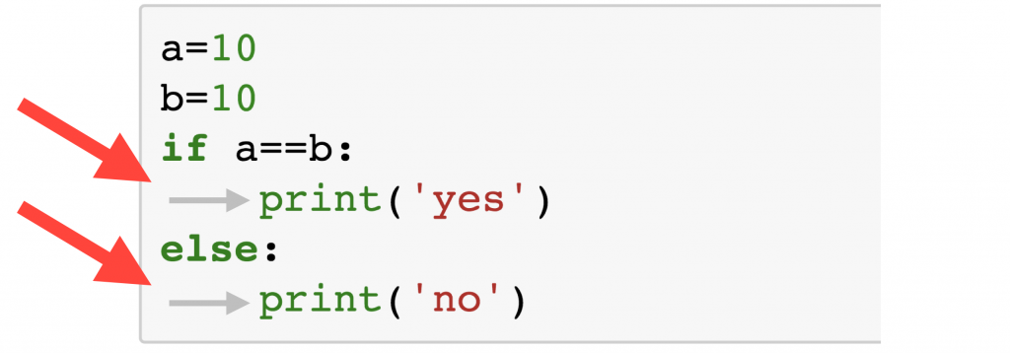
Common Mistakes
Never miss!!!:
Colons
Indentations

Slide 17

Common Mistakes
Mistake 1: The operator for equality consists of two equals signs
Mistake 2: To use and where or is needed or vice-versa. Consider the following if statements
Mistake 3:

Slide 18
Exercises
Exercise 1:
Write a program that asks the user to enter a length in centimetres.
If the user enters a negative length, the program should tell the user that the entry is invalid. Otherwise, the program should convert the length to inches and print out the result.
There are 2.54 centimetres in an inch.
Exercise 2:
Write a program that asks the user for two numbers and prints Close if the numbers are within 20 of each other and Not close otherwise.

Slide 19
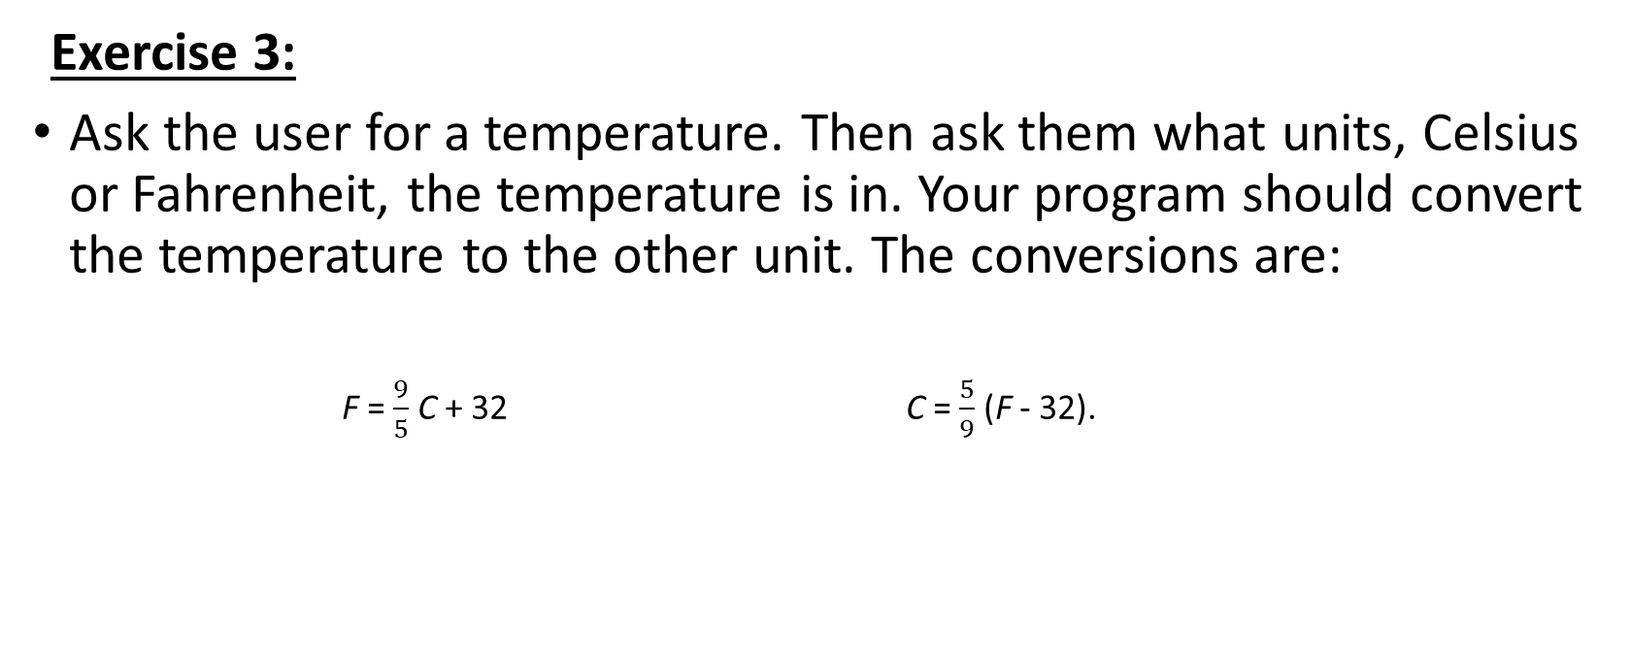
Exercises
Exercise 3:
Ask the user for a temperature. Then ask them what units, Celsius or Fahrenheit, the temperature is in. Your program should convert the temperature to the other unit. The conversions are:
F = $\frac{9}{5}$ C + 32 C = $\frac{5}{9}$ (F - 32).

